Slide 1
Project Deliverable
Tony Lam and Amar Sohail

Slide 2
Demographic of the Project
Our project was created for educational purposes. The goal of our project is to simulate a keylogging attack to show users how a cyber attacker can obtain sensitive information from their victim.
By providing the source code, we allow users to:
Understand the inner workings of a keylogger and its capabilities.
Learn about the potential vulnerabilities that keyloggers exploit in systems.
Develop a deeper understanding of how to detect and mitigate keylogging attacks in real-world scenarios.
This project aims to educate users about cybersecurity risks and promote ethical use of such tools for learning and research purposes, emphasizing the importance of safeguarding sensitive information.

Slide 3
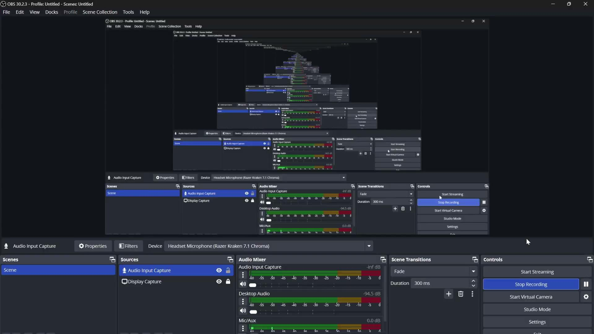
How to Create an .exe File with

Slide 4

How to Bypass Firewall

